Slide 1

Static test fire RIG progress report
Kevin Bucher
Reilly Webb
Nick Clegg

Slide 2
Objectives
Experimentally obtain static thrust data from an E9-6 rocket engine through the use of a 100 lbf load cell
Experimental Impulse will be calculated and compared to the expected value
The data will be analyzed and approximated as a first or second order system
System parameters will be obtained and used to find a theoretical thrust curve
Parameters of the engine will be adjusted to understand how the inner workings of the engine affect the system time constant
Build off of this prototype to develop a test fire rig for larger engines

Slide 3
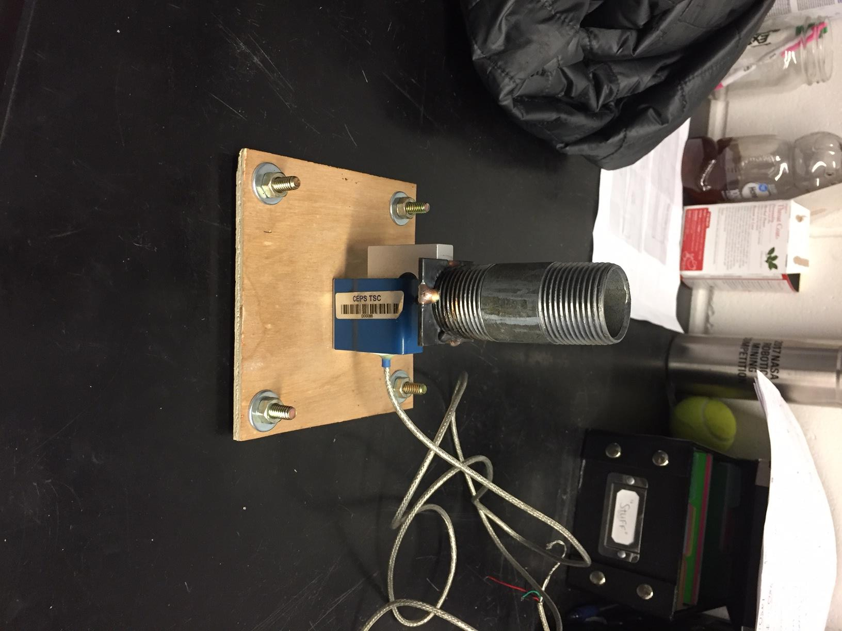
SETUP
Engine thrust applied downward
5.1 lbs. Expected max thrust
SM-100 load cell utilized(100lbf)
Load cell runs through AD620-03 amplifier to oscilloscope

Slide 4
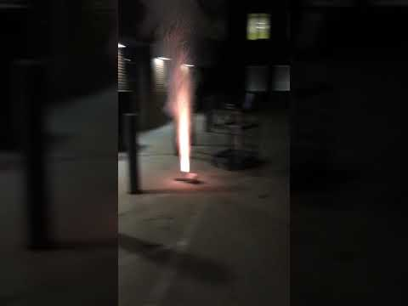
Experiment

Slide 5
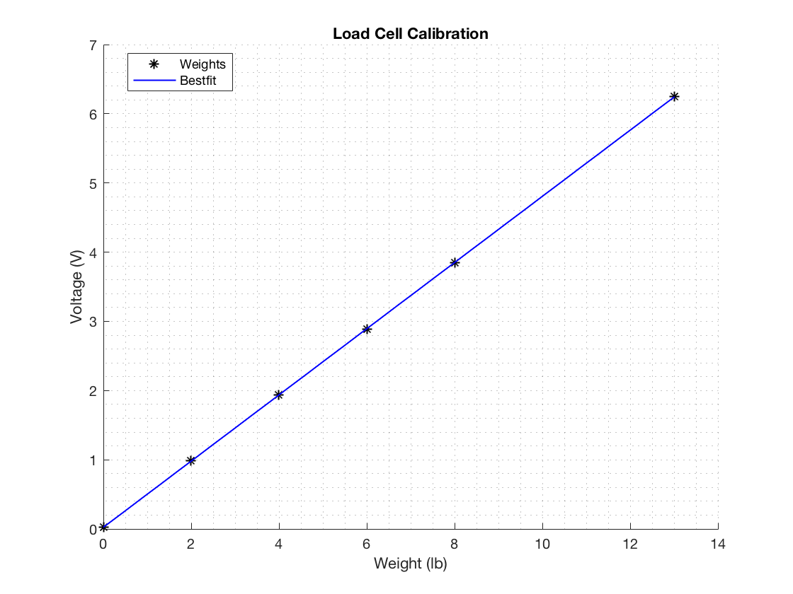
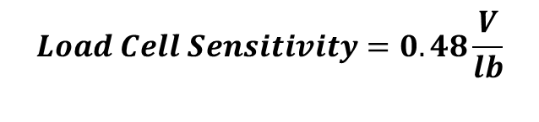
Calibration
$$Load Cell Sensitivity=0.48\frac{V}{lb}$$

Slide 6
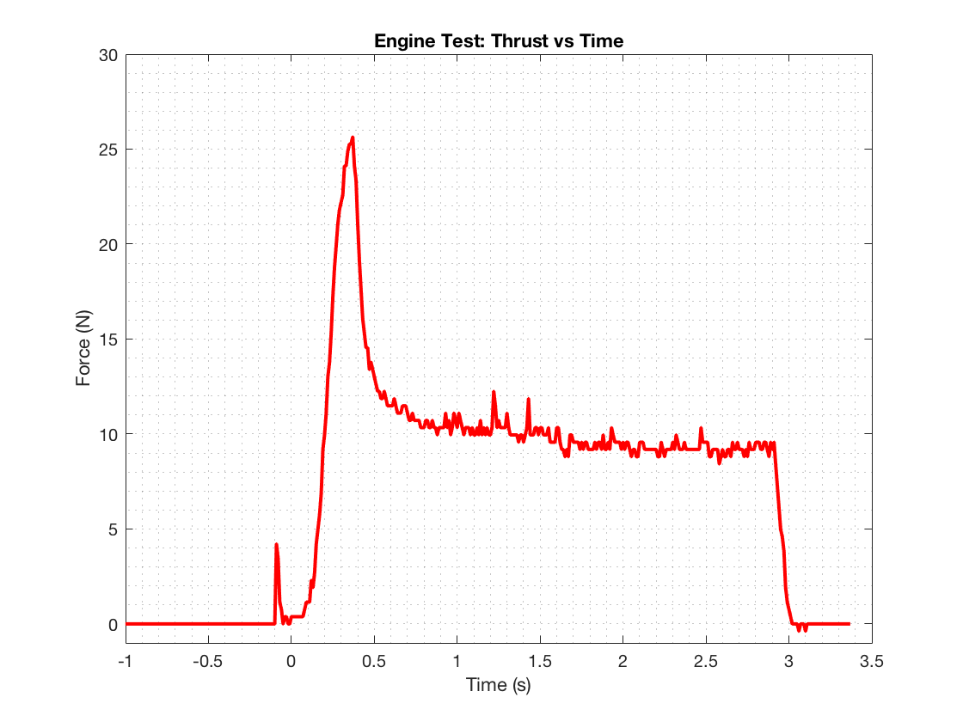
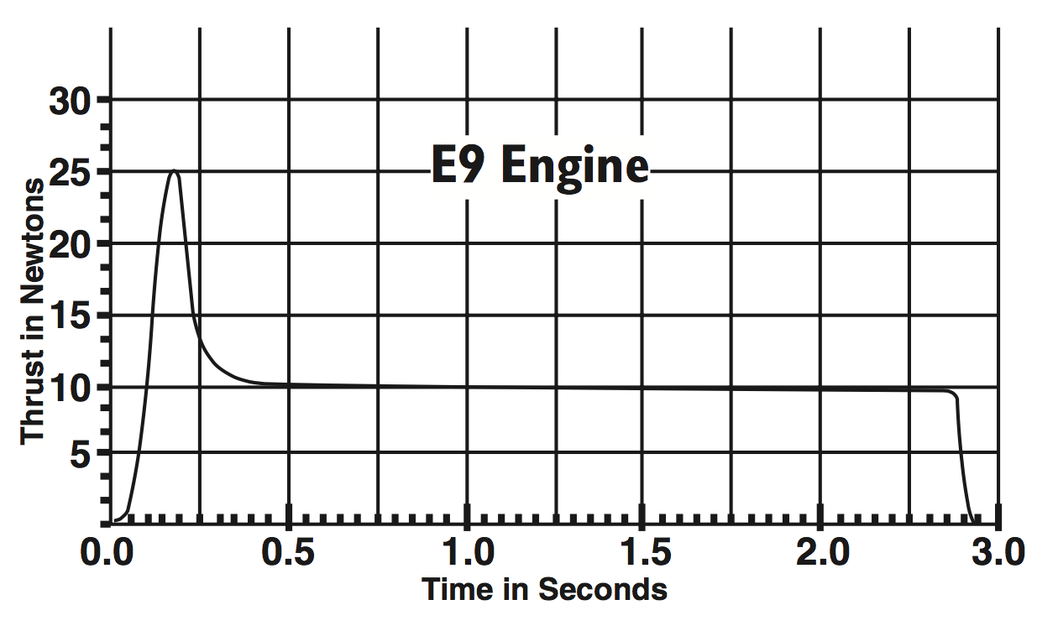
data
Experimental: Expected:

Slide 7
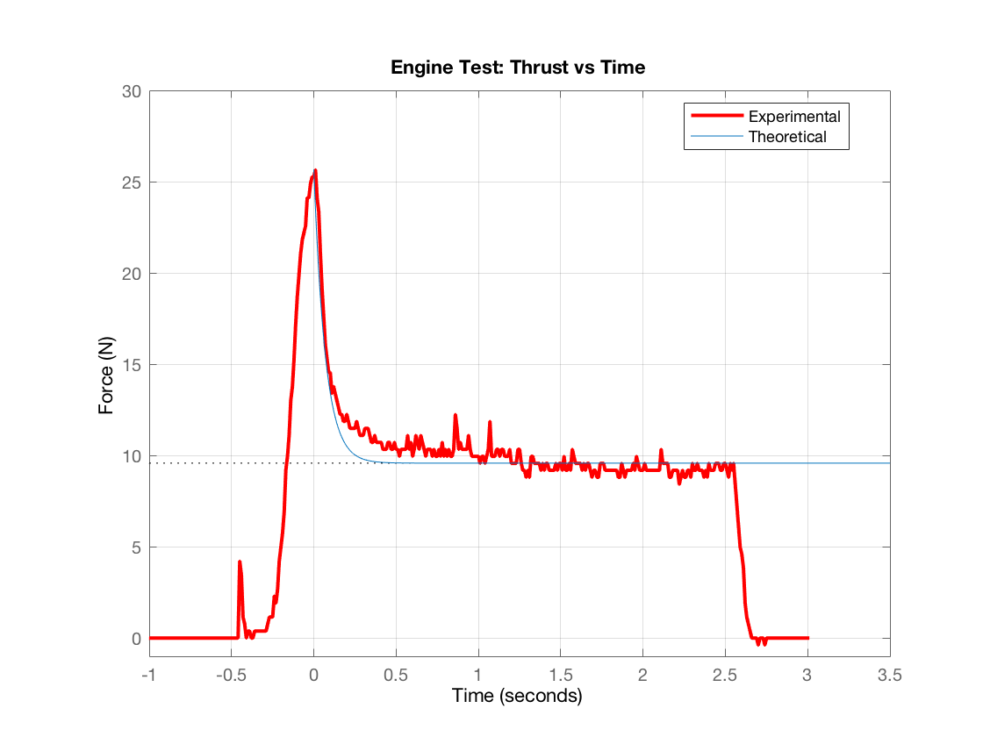




AnAlysis
$$Black Powder Mass:$$
$$m =0.0358 kg$$
Response Time:
$$t=2.54 s$$
$$mass flow rate= \frac{m}{t}$$
$$Thrust=16.1 N$$
$$K=\frac{Thrust}{Mass flow rate}$$
$$\frac{F(s)}{\dot{m}(s)}= \frac{K}{τs+1}$$
Time Constant (s) | 0.07
Maximum Thrust (N) | 25.7
Steady-State Thrust (N) | 9.57

Slide 8
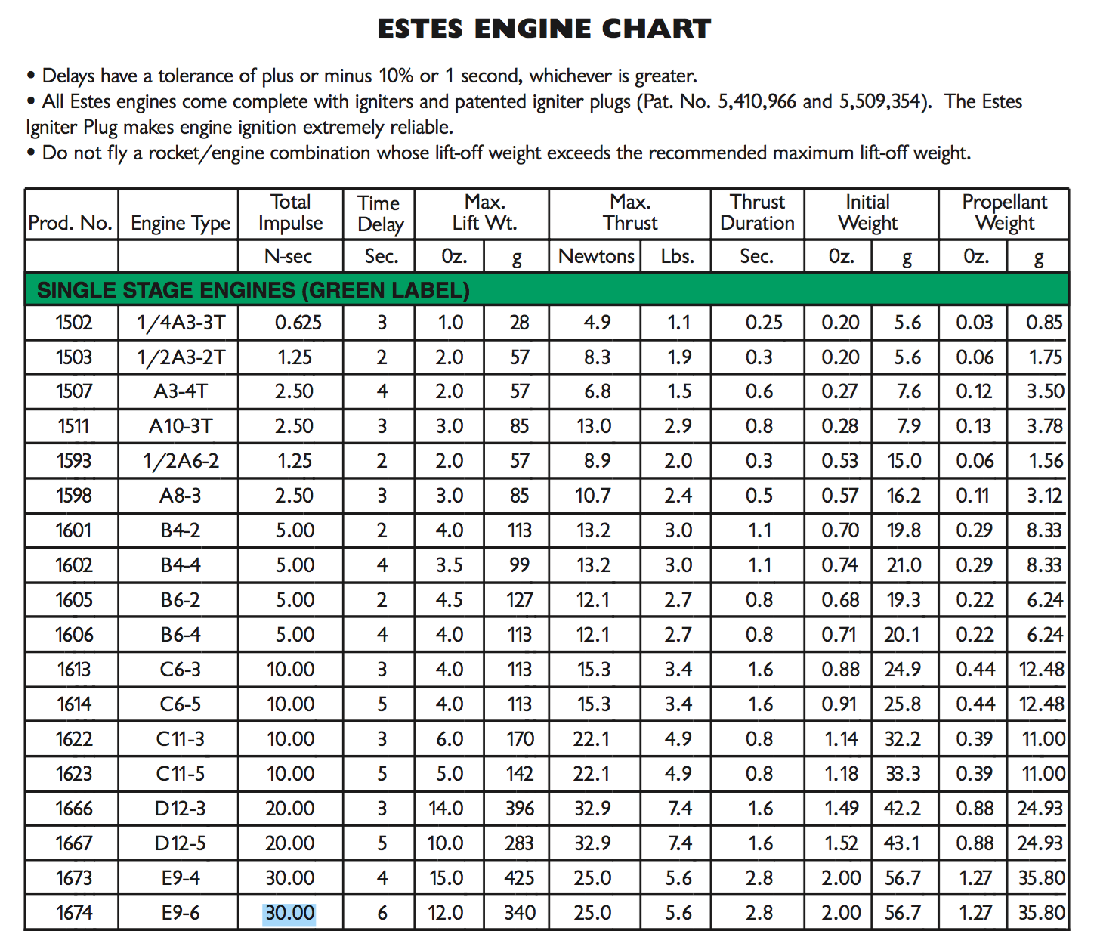
Continued Analysis
Calculated Impulse:
I = 30.5 N-s
Expected Impulse:
I = 30 N-s

Slide 9
Potential Work to be done
Adjust parameters of the engine to understand how thrust is controlled and which parameters affect the system time constant(diameter, length, mass flow rate, burn time, etc.)
Potentially calculate theoretical thrust with other methods and compare to experimental data

Slide 10
conclusion
Part of the response can be approximated to be a first order system
Obtaining other theoretical response is possible but may be out of the scope of the project
Plan to also estimate the thrust response using a first order system response in the time domain
Will accept further analysis recommendations

